Slide 1




Direct Air Capture Using a Moisture Swing: Electrochemical Impedance Spectroscopy for Characterization
DaJae Doral
Mentor: Dr. Jennifer Wade
Northern Arizona University
Arizona Space Grant Symposium April 23, 2022

Slide 2
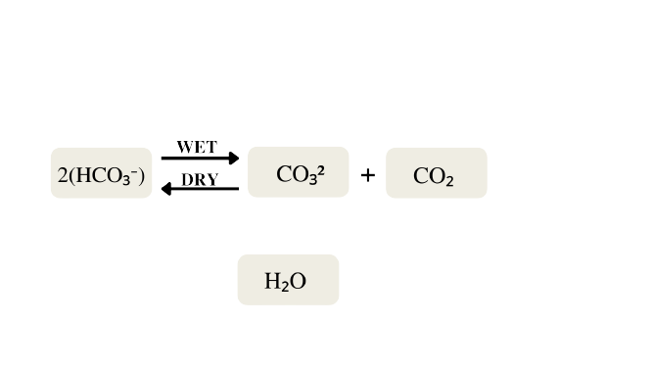
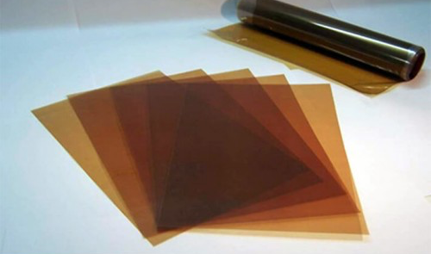
Introduction to
Carbon Removal
Carbon removal will prevent a temperature increase above 2°C
Anion exchange materials for direct air capture
This process is driven by a change in moisture rather than applied pressure, heat, or electricity
Disclaimer for unbalanced equations
  Both hydrated and free water influence this chemistry
  Hypothesized the hydrated ions are destabilized when confined in nano-environments
Figure 1. Fumasep Anion-Exchange Membrane

Slide 3

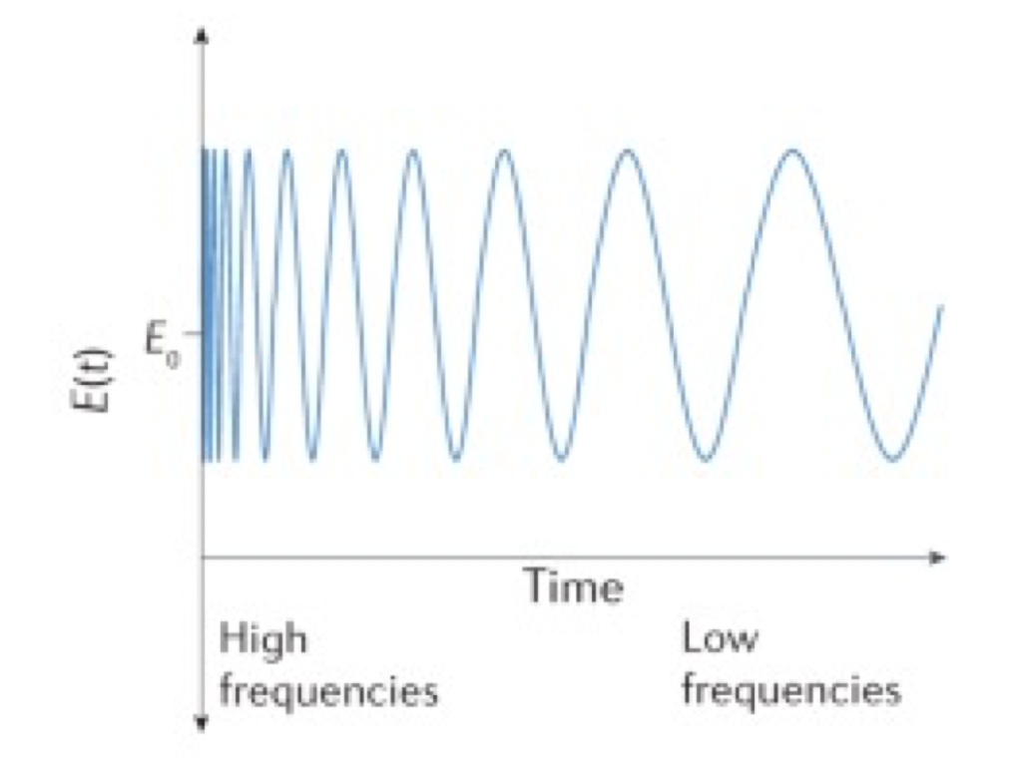
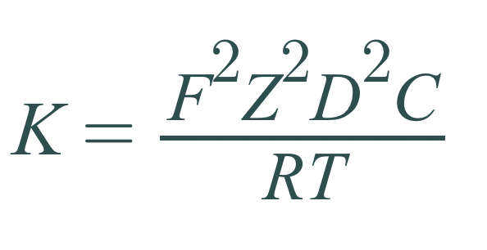
Methodology
Electrochemical Impedance Spectroscopy (EIS) is a method of measuring electrical resistance by sweeping through a range of frequencies at a single alternating amplitude using potentiostat
Measured impedance is used to characterize the transport of bicarbonate and carbonate
The rate of transport is influenced by humidity
Nyquist plots are used to interpret EIS measurements
From resistance, conductivity and diffusivity of the membrane can be calculated
From capacitance, chemical rates can be characterized
Imaginary Z
Real Z
Figure 2. Example Nyquist Plot
Figure 3. Perturbation signal
K = Conductivity
F = Faraday’s Constant
Z = Charge
D = Diffusivity
C = Number of Charge Sites
R = Ideal Gas Constant
T = Characteristic Length
Equation 1. Nernst-Einstein Equation

Slide 4
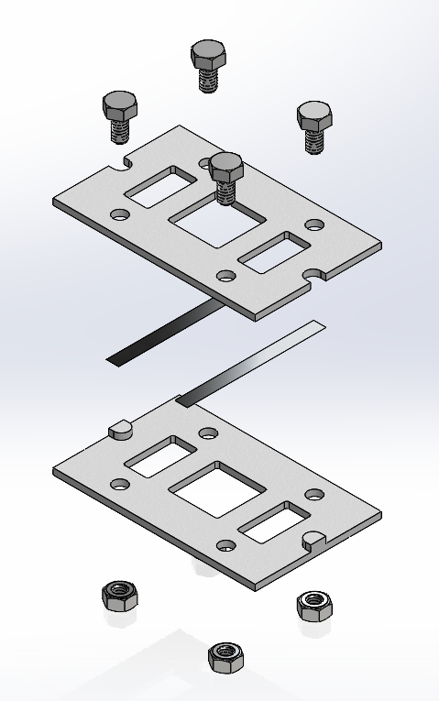
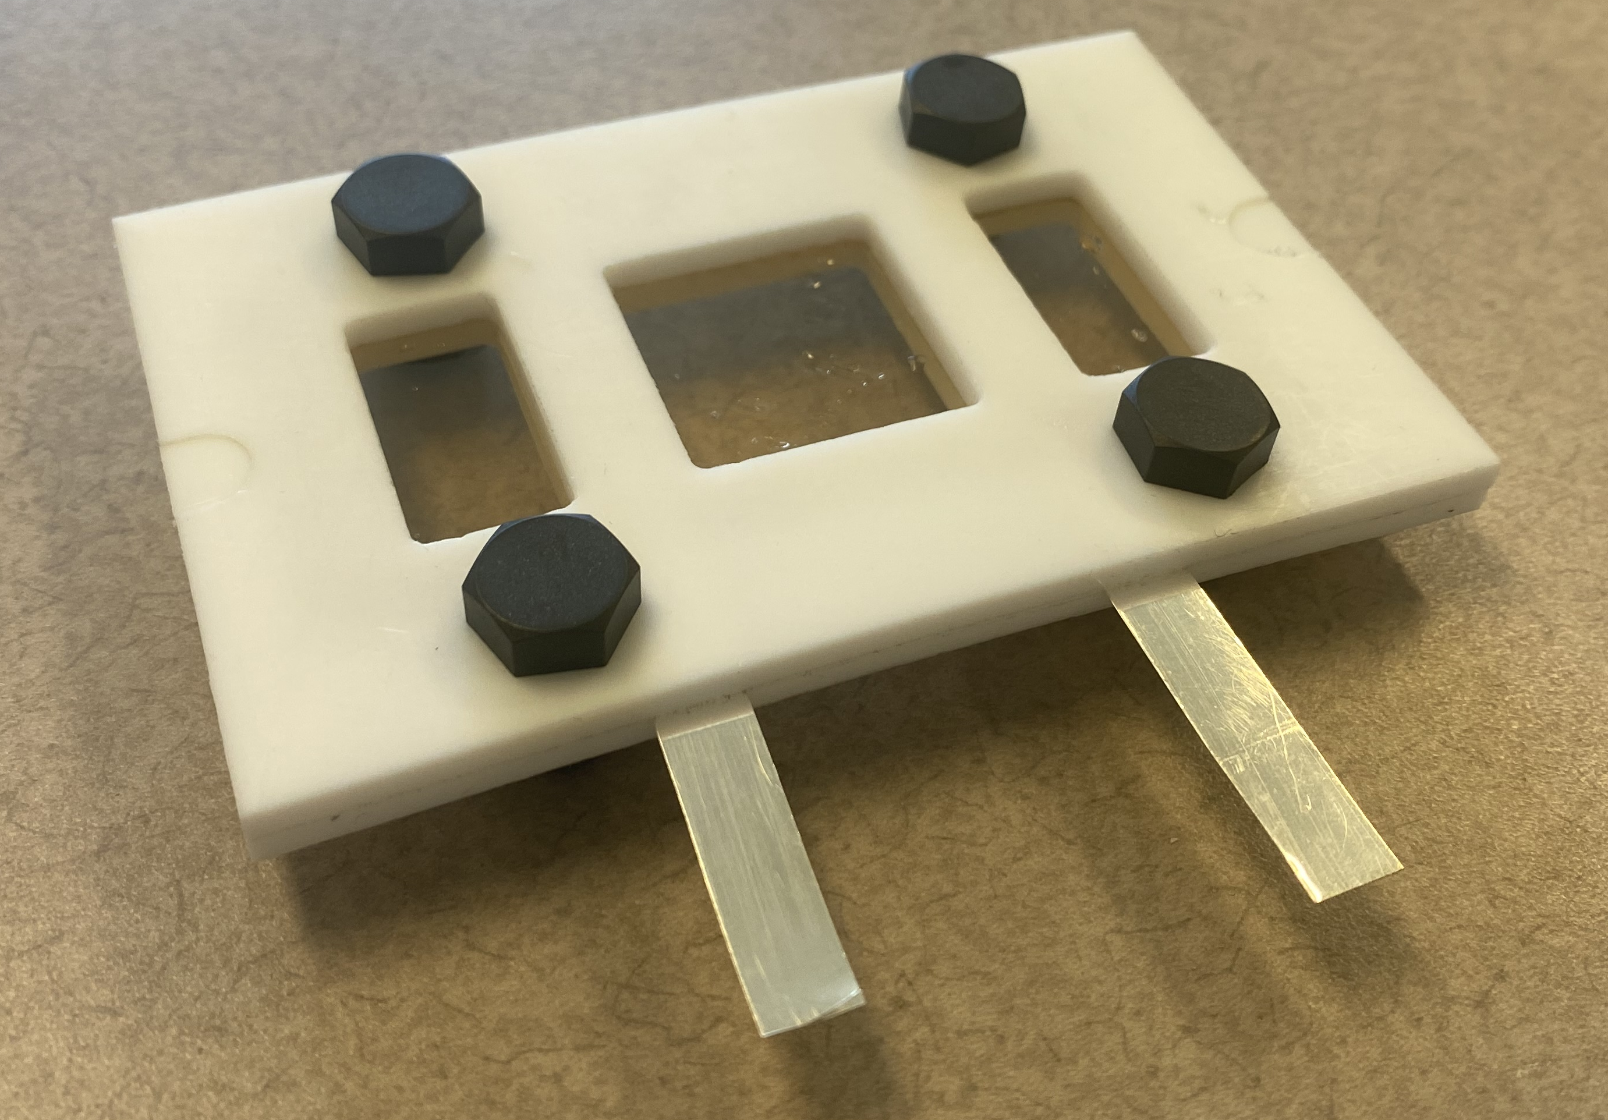
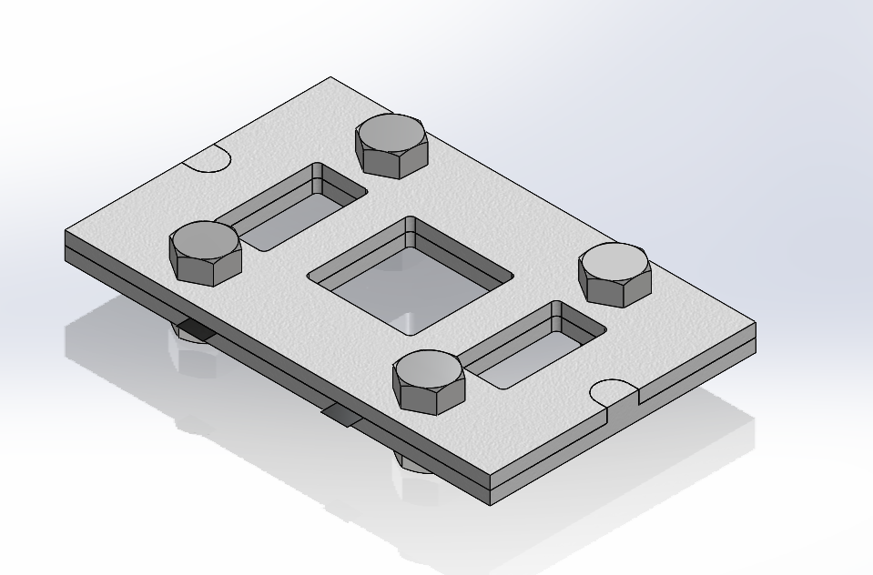
Sample Holder Design
In plane EIS measurement sample Holder
  PTFE
  Silver leads
  Fiberglass hex nuts and bolts
  Dimensions 4.5”x3”x0.25”
  Measures across sample
  Allows for membrane to interact with surroundings
Figure 4. Loaded Sample Holder
Figure 5. Sample Holder CAD
Figure 6. Sample Holder Exploded View

Slide 5
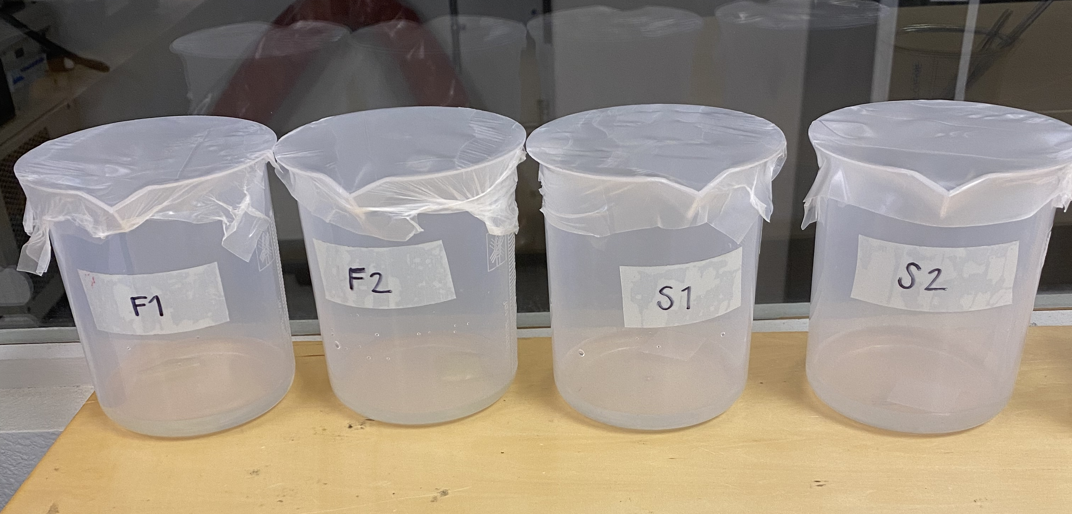
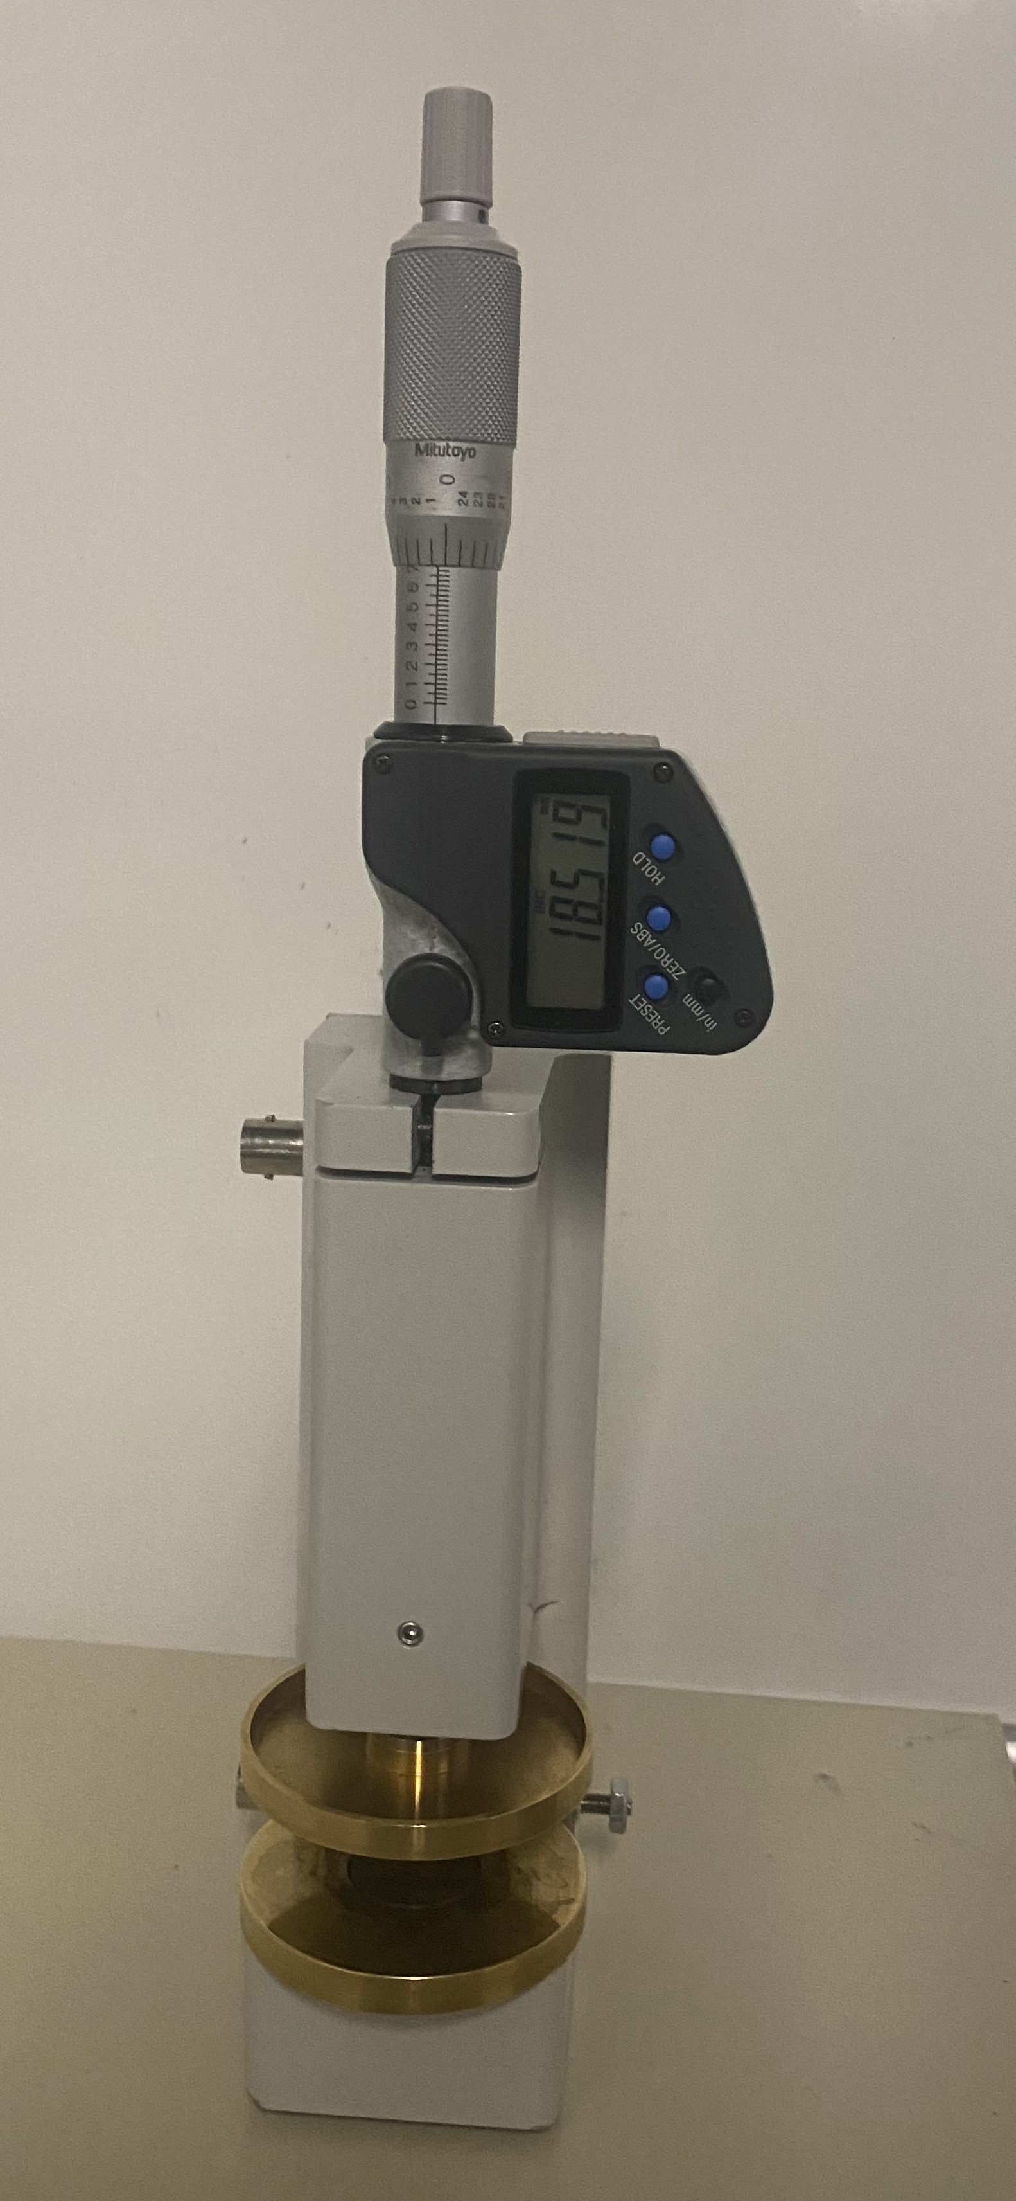
Experiment Results
Samples in Cl state soaked in DI water
Samples in HCO3 state ion exchanged then soaked in DI water
Frequency range 1MHz to 1Hz
These experiments lead to an understanding of measurement uncertainty
Figure 7. Experiment Nyquist Plot
Figure 8. Through-Plane Sample Holder
Figure 9. Sample Preparation

Slide 6
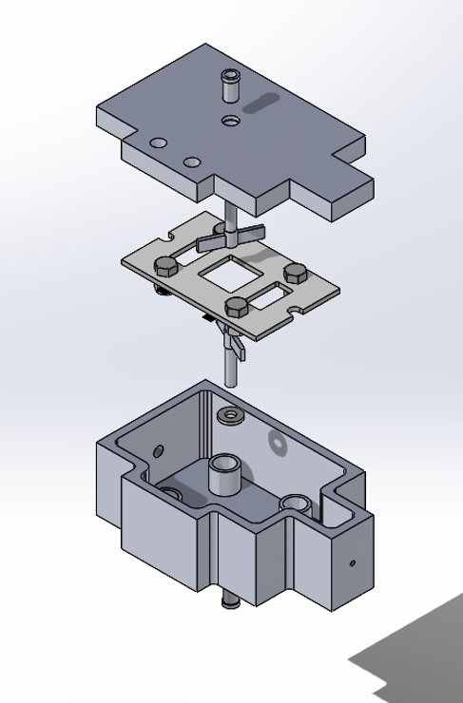
Conclusion
Importance
  Characterizing rates of C02 capture gives the cost of the process
  Process cost plays a key role in practicality
Future work
  Work with in-plane sample holder
  New sample preparation techniques
  Different commercial membranes
  Implementing moisture swing chamber
Figure 10. Moisture Swing Chamber Exploded View

Slide 7
Acknowledgments
This work was made possible thanks to:
  Dr. Jennifer Wade (Mentor)
  Northern Arizona University
    Mechanical Engineering Department
  Arizona Space Grant Consortium
    Paloma Davidson (Program Coordinator)
    Dr. Christopher S. Edwards (Program Director)
  ARPA-E

Slide 8
Thank you
Questions?

Slide 9
Citations
“Fumasep FAA-3-50.” Fuel Cell Store, https://www.fuelcellstore.com/fumasep-faa-3-50.
Heimerdinger, P., Rosin, A., Danzer, M., & Gerdes, T. (2019). A Novel Method for Humidity-Dependent Through-Plane Impedance Measurement for Proton Conducting Polymer Membranes. Membranes, 9(5), 62. MDPI AG. Retrieved from http://dx.doi.org/10.3390/membranes9050062
Shangshang Wang, Jianbo Zhang, Oumaïma Gharbi, Vincent Vivier, Ming Gao, et al.. Electrochemical impedance spectroscopy. Nature Reviews Methods Primers, 2021, 1, 41 (21p.). 10.1038/s43586-021- 00039-w . hal-03258251
Soboleva, Tatyana, et al. “Investigation of the through-Plane Impedance Technique for Evaluation of Anisotropy of Proton Conducting Polymer Membranes.” Journal of Electroanalytical Chemistry, vol. 622, no. 2, 2008, pp. 145–152., https://doi.org/10.1016/j.jelechem.2008.05.017.

